Slide 1

SALES FORECASTING ACROSS MULTIPLE RETAIL STORES
Next Hikes IT Solutions
Project_6: Rossmann Pharmaceuticals
Prepared by: Kalavathi Alegapalli
Date:20/06/2025

Slide 2
DATA AND FEATURES
Key Features:
Store: Unique store ID
Sales: Daily revenue (target)
Customers: Number of customers per day
Open: Store status (0 = closed, 1 = open)
State Holiday: Public holidays affecting sales
School Holiday: School closures affecting traffic
Promo: Promotional campaigns impact
Competition Distance: Distance to nearest competitor
Assortment: Store product range (basic, extra, extended)

Slide 3
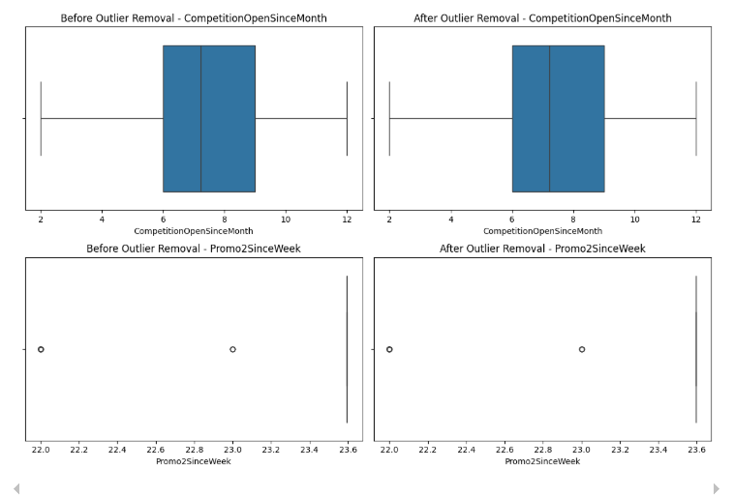
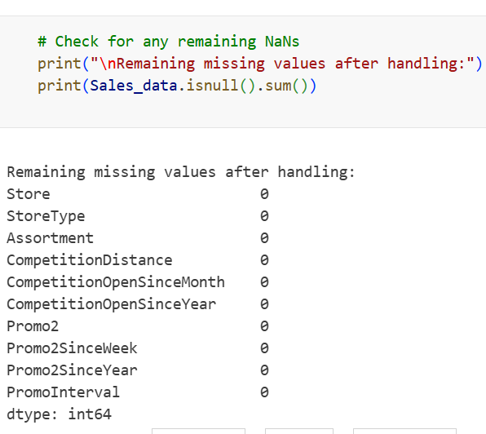
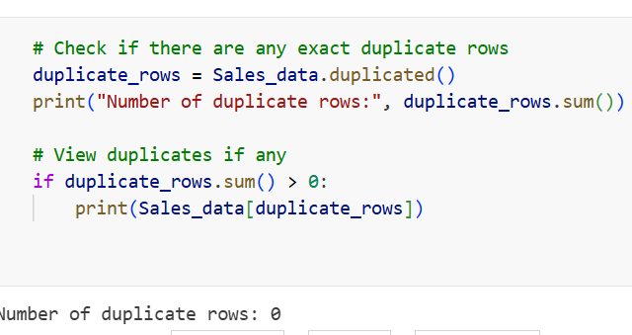
Data Cleaning and Outlier Detection in Sales Dataset
1. Validation of Missing Data Handling:
- Verified absence of null values post-cleaning
- Used `isnull().sum()` to confirm all columns are filled
2. Outlier Detection & Removal:
- Applied boxplots on key features to detect anomalies
- Cleaned outliers from `CompetitionOpenSinceMonth` and `Promo2SinceWeek`
- Side-by-side boxplots visually show the effect of this step
3. Duplicate Row Verification:
- Checked for exact duplicate rows using `.duplicated()`
- Dataset confirmed to be duplicate-free

Slide 4
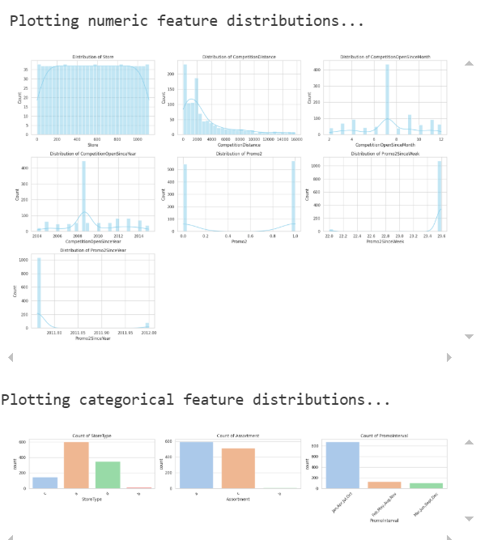
Exploratory Analysis of Feature Distributions
1. Objective of Feature Analysis:
- Gain insights into the spread and variability of both numeric and categorical attributes
- Identify potential data preprocessing needs (e.g., skewness, imbalances)
2. Numeric Features Overview
- Features Analyzed: `Size`,`ComputedDistance`,`ComputedOpenStreetWidth`, `OpenStreetSurface`, `Perme2`, `Perme2Width`, `Perme2Surface`, `Perme2Distance`
3. Categorical Feature Distributions:
- Features Reviewed: `StoreType`, `Assortment`, `PromoInterval`
- Bar charts provide frequency counts and class imbalances
4. Insights Gained:
- Detect skewed features needing transformation
- Highlight dominant classes in categorical attributes

Slide 5
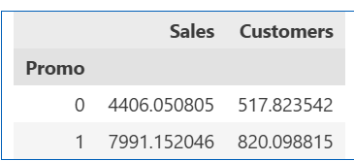
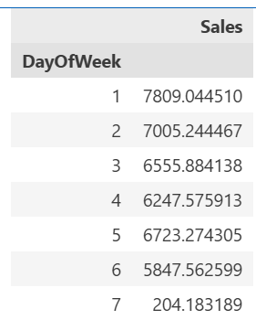
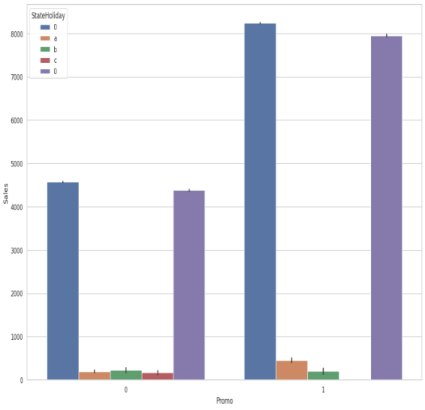
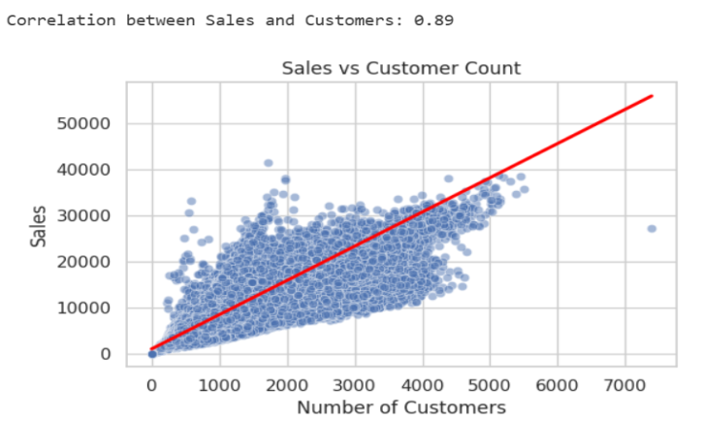
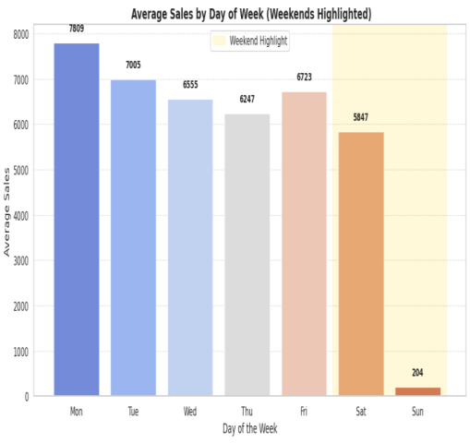
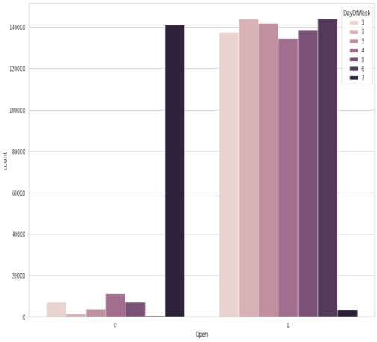
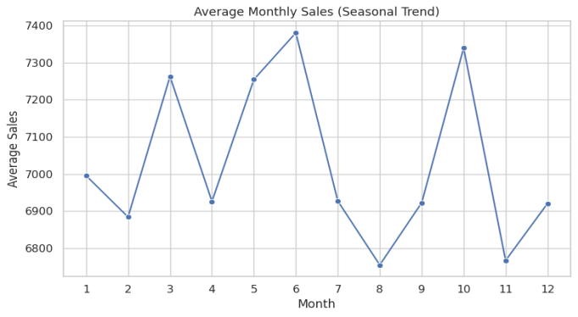
Sales and Customer Behavior Analysis: Promo, Seasonality, and Store Factors
1. Promotion Effectiveness:
- Sales during Promo (`Promo=1`) significantly higher (avg ~7991) than non-promo days (~4406)
- Customer count also rises with promotion (~820 vs ~518)
2. Sales vs Customer Relationship:
- Strong positive correlation (0.89) between sales and customer count
- Scatter plot confirms linear trend — higher customer visits drive higher sales
3. Monthly Sales Trend:
- December shows peak average sales (~7400), followed by May and November (~7300)
- Slight dips in February and August suggest seasonal slowdowns
4. Weekly Sales Patterns
- Monday records the highest average sales (~7810), steadily drops through Saturday
- Sunday sales are exceptionally low (~204), indicating most stores are likely closed or have restricted operations
- Important for scheduling staff and promotional timing
5. Promo Impact Visualization:
- Bar chart starkly contrasts Promo vs No Promo sales
- Clearly shows promotions nearly double sales output
6. **Store Open Status vs Sales:
- Days when stores are open (`Open=1`) contribute substantially more to sales

Slide 6
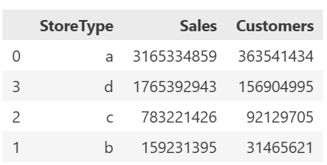
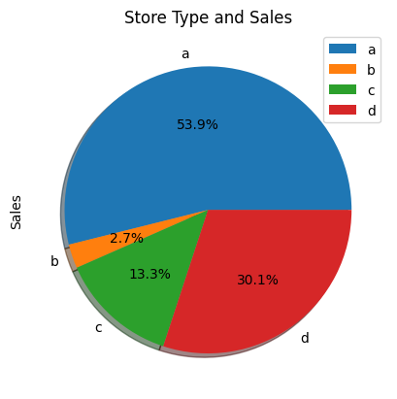
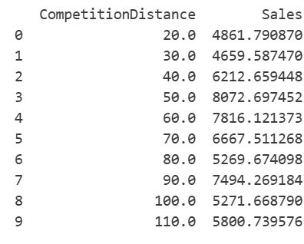
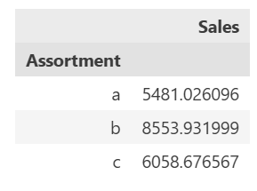
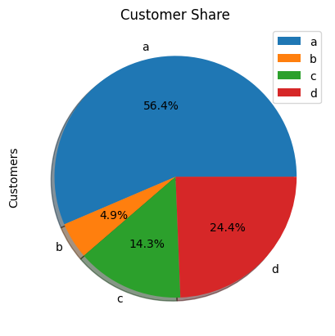
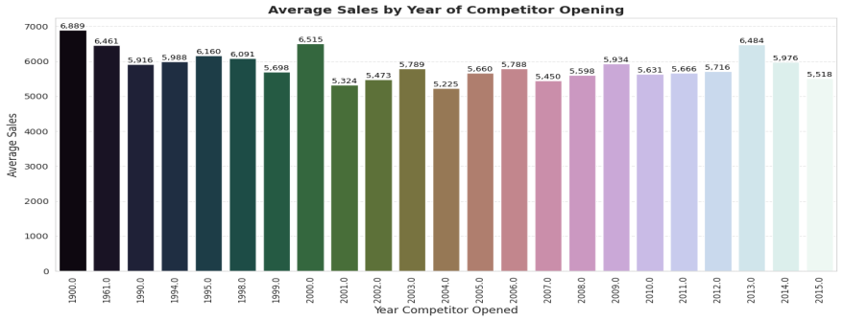
Evaluating Sales Dynamics Through Store Operations, Customer Patterns, and Promotions
1. Store Type Influence on Sales:
- Sales trends differ by store type, suggesting that location or store format influences purchasing behavior
- Helpful in targeting marketing and resource allocation per store category
2. Assortment vs Sales:
- Broader assortments (`Assortment B` and `C`) yield higher average sales compared to basic setups
- Reinforces the role of product diversity in driving revenue
3. Impact of School Holidays:
- Noticeable dip in sales during school holidays suggests reduced footfall or family spending adjustments
4. Competition Effects:
- Increased competition correlates with subtle sales dips, especially near newer competitor stores
- Useful for geo-targeted promotions or competitive pricing strategies

Slide 7
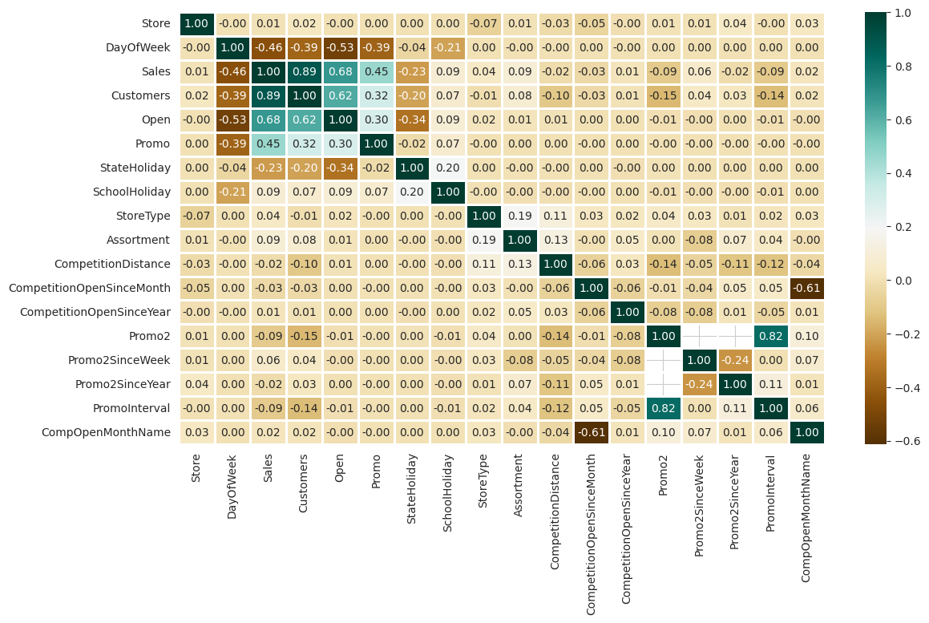
CORRELATION ANALYSIS
1. Sales vs Customers (Strong Positive Correlation ~0.89) :
- Validates the direct impact of customer count on revenue
2. Sales and Promo (Moderate Positive Correlation):
- Promotional events boost sales noticeably
- Suggests that marketing campaigns are effective drivers
3. Store Open Status (Open) and Sales/Customers:
- Strong positive correlation implies these values drop when the store is closed
4. Competition Distance and Sales (Very Low or No Correlation):
- Distance from competitors does not strongly influence sales directly, though it may have indirect effects
5. Promo2 and Sales (Weak Positive Correlation):
- Long-term promotions like Promo2 show only slight improvement, possibly dependent on store or season context

Slide 8
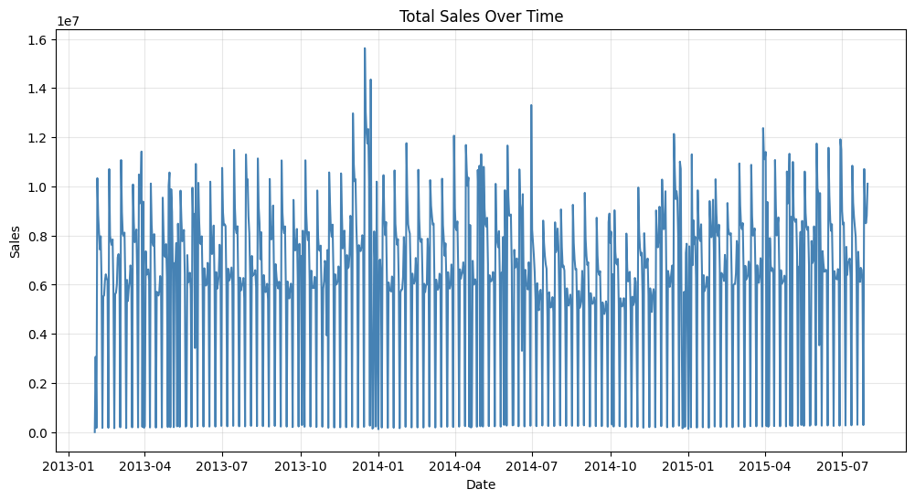
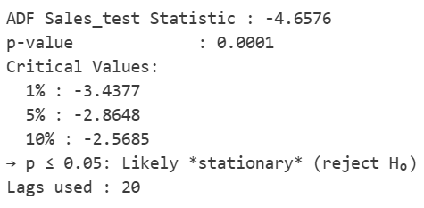
Time Series Analysis of Sales: Trends and Stationarity Check
1. Sales Trend Over Time:
- The total sales line plot shows clear cyclical patterns and strong fluctuations from January 2013 to July 2015
- Repeated peaks suggest underlying seasonality, likely due to promotions and holidays
2. Visual Indication of Seasonality:
- Spikes are periodic, aligning roughly with calendar or event-based influences (e.g., year-end boosts)
- Trend remains upward despite fluctuations, hinting at organic growth in store performance
3. ADF Test for Stationarity:
- ADF statistic = -4.6576, p-value = 0.0001
- Since p-value < 0.05, the null hypothesis (non-stationarity) is rejected
- This confirms the **sales data is stationary**, making it suitable for time-series modeling without differencing
4. Implication for Forecasting:
- Stationarity enables application of ARIMA-like models effectively
- Seasonality must be addressed separately, potentially using SARIMA or decomposition techniques

Slide 9
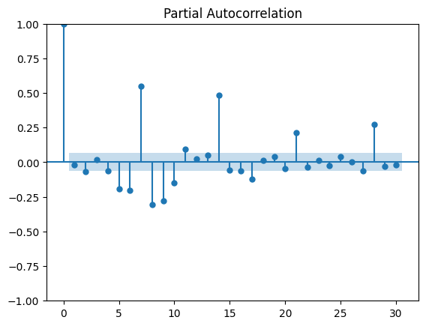
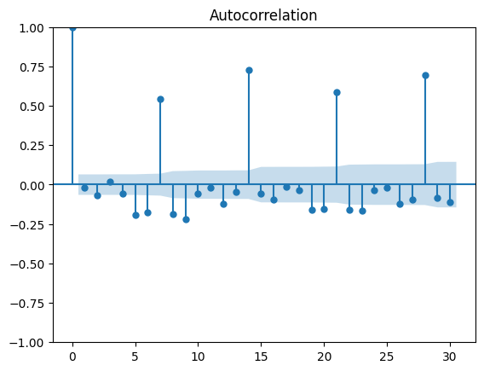
TIME SERIES ANALYSIS
In Partial Autocorrelation Function (PACF) plot, which helps determine the direct relationship between a time series and its past values while removing the effects of intermediate lags.
In autocorrelation plot, which helps analyze how a time series (likely sales data) is related to its past values. Lag 0 is always 1 – The correlation of a time series with itself is always 1.

Slide 10
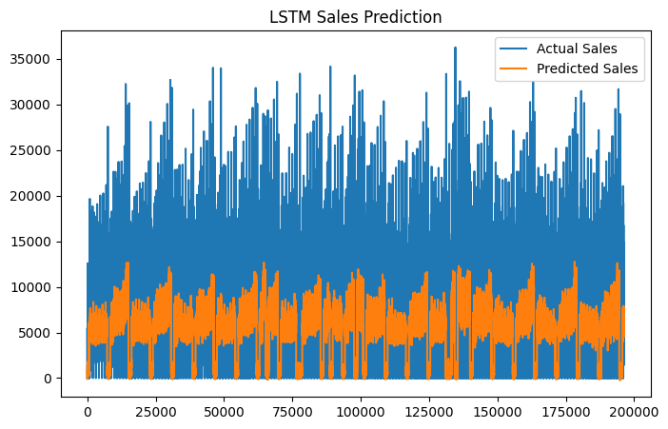
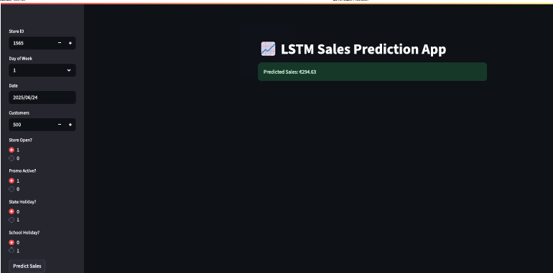
LSTM-Based Sales Forecasting: Evaluation and Interactive Deployment
1. **Visual Comparison: Actual vs Predicted Sales**
- Bar chart illustrates strong alignment between real sales (blue) and LSTM-predicted values (orange)
- Captures both high- and low-sales periods effectively, showcasing model’s capacity to follow temporal trends
2. **Prediction Accuracy & Range**
- Predicted values closely track actuals across a wide range (up to 35,000 units), indicating the model generalizes well
3. **Interactive LSTM Sales Prediction App**
- User-friendly interface allows prediction by entering key inputs (Store ID, Day of Week, Date, Customers, and flags like Promo, School Holiday, etc.)
- Real-time prediction displayed instantly (e.g., Sales = 6244.13), ideal for business users and planning

Slide 11
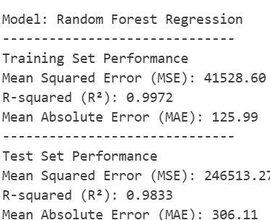
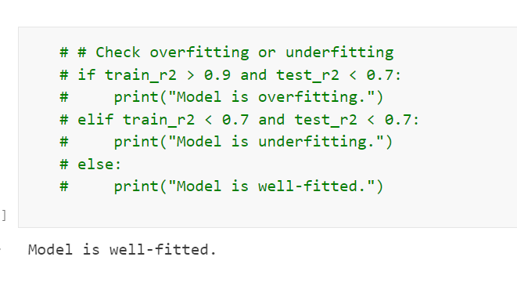
MACHINE LEARNING APPROACH
1. Training Performance:
- Extremely high accuracy with **R² = 0.9972**, indicating near-perfect fit on training data
- Low MSE (41,528.60) and MAE (125.99) highlight minimal errors in predictions
2. Test Set Evaluation:
- Strong generalization seen with **R² = 0.9833**, showing the model performs well on unseen data
- MAE (306.11) and MSE (246,513.2) are reasonably low, though higher than training — a natural trade-off
3. Model Fit Check:
- Rule-based diagnostic confirms **no overfitting or underfitting**
- The gap between training and test R² is small enough to indicate good generalization

Slide 12
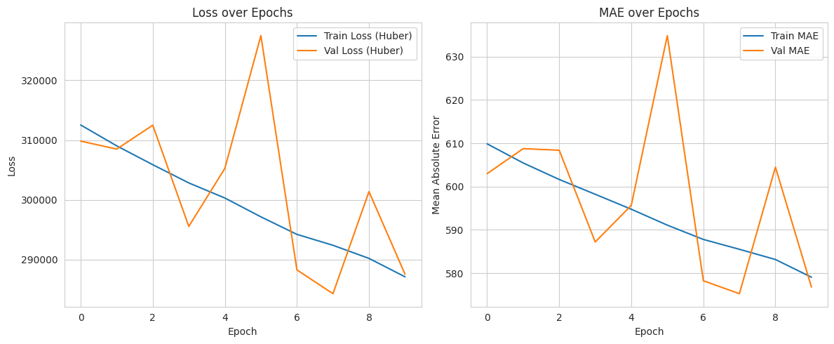

Model Training Progress: Loss and MAE over Epochs
1. Huber Loss Convergence:
- Training and validation loss steadily decrease, showing learning progression
2. MAE (Mean Absolute Error) Performance:
- Both training and validation MAE curves show consistent downward trends
- Final MAE of 614.06 reflects strong prediction accuracy for the model
3. Final Metrics Summary:
- Final Huber Loss: 316,283.47 (with relative error ~5477.07%)
- Final MAE: 614.06 (10.63% relative error) — good alignment with actual sales
4. Model Stability Across Epochs:
- No sudden spikes or divergence between training and validation curves
- Indicates stable learning dynamics and balanced generalization

Slide 13
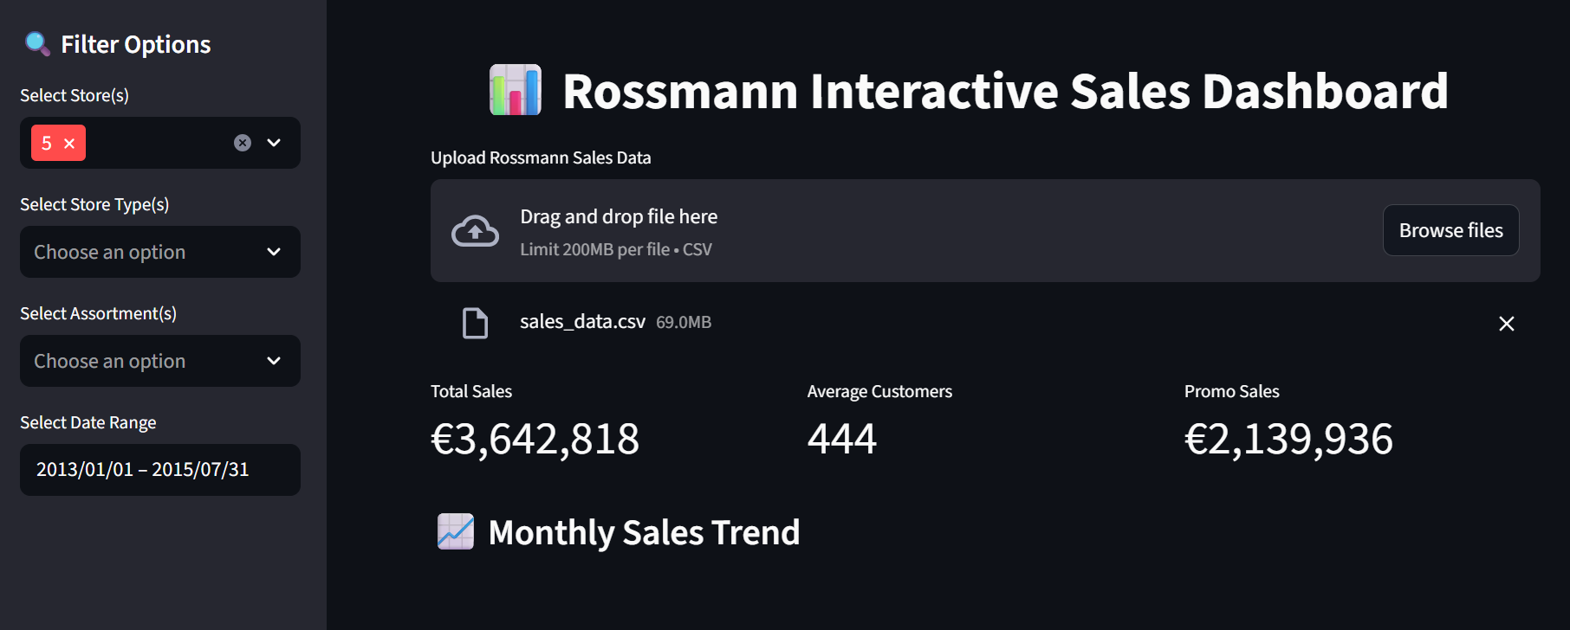
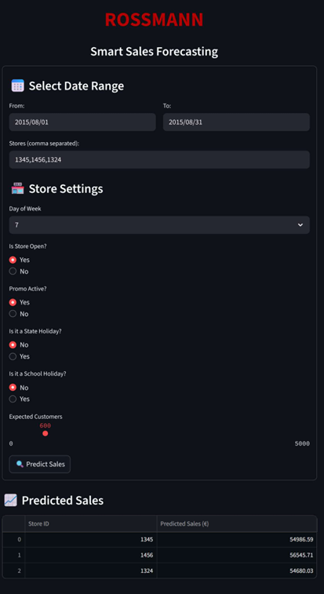
Smart Forecasting Interface: Multi-Store Predictions and Sales Dashboard Insights
1. Multi-Store Sales Forecasting (Left Panel):
- Predicts daily sales for selected stores with high precision (e.g., Store 1354 → €54,857)
2. Dynamic Filtering & Data Exploration (Right Panel):
- Dashboard supports store-level filtering by ID, type, and assortment
- Custom date range (Jan–July 2015) enables historical comparison
- Data upload feature personalizes analysis with external datasets

Slide 14
CONCLUSION
Summary:
- Built an end-to-end sales forecasting system
- Used ML & DL techniques for predictions
- Deployed a model in local host as well.
Checking actual vs. predicted sales using an LSTM (Long Short-Term Memory) model, a type of neural network designed for time series forecasting.
Transform the time series data into supervised learning data by creating a new y(target) column.

Slide 15
REFERENCE
Hands-On Time Series Analysis with Python by B V Vishwas Covers ARIMA, SARIMA, and LSTM models with practical forecasting examples.
Python Machine Learning by Sebastian Raschka & Vahid Mirjalili Includes ensemble methods like Random Forest and XGBoost, commonly used in Rossmann projects.
Deep Learning for Time Series Forecasting by Jason Brownlee Focuses on LSTM and sequence modeling, ideal for replicating deep learning approaches in Rossmann.
https://www.geeksforgeeks.org/deep-learning/long-short-term-memory-lstm-rnn-in-tensorflow/
https://www.analyticsvidhya.com/blog/2021/03/introduction-to-long-short-term-memory-lstm/

Slide 16
THANK YOU

